Slide 1
DEVOPS CI/CD MONITORING PLATFORM
Arpit Sharma
12306106

Slide 2
INTRODUCTION
DevOps is a modern software development methodology that integrates development and operations to automate software delivery processes.
This project aims to implement a complete DevOps workflow by integrating multiple DevOps tools to automate application deployment, monitoring, and infrastructure provisioning. The project demonstrates Continuous Integration and Continuous Deployment (CI/CD), containerization, orchestration, real time monitoring, and Infrastructure as Code (IaC).
A simple Node.js web application is containerized using Docker, deployed on Kubernetes, automated through Jenkins pipelines, monitored using Prometheus and Grafana, and cloud infrastructure is provisioned using Terraform.

Slide 3
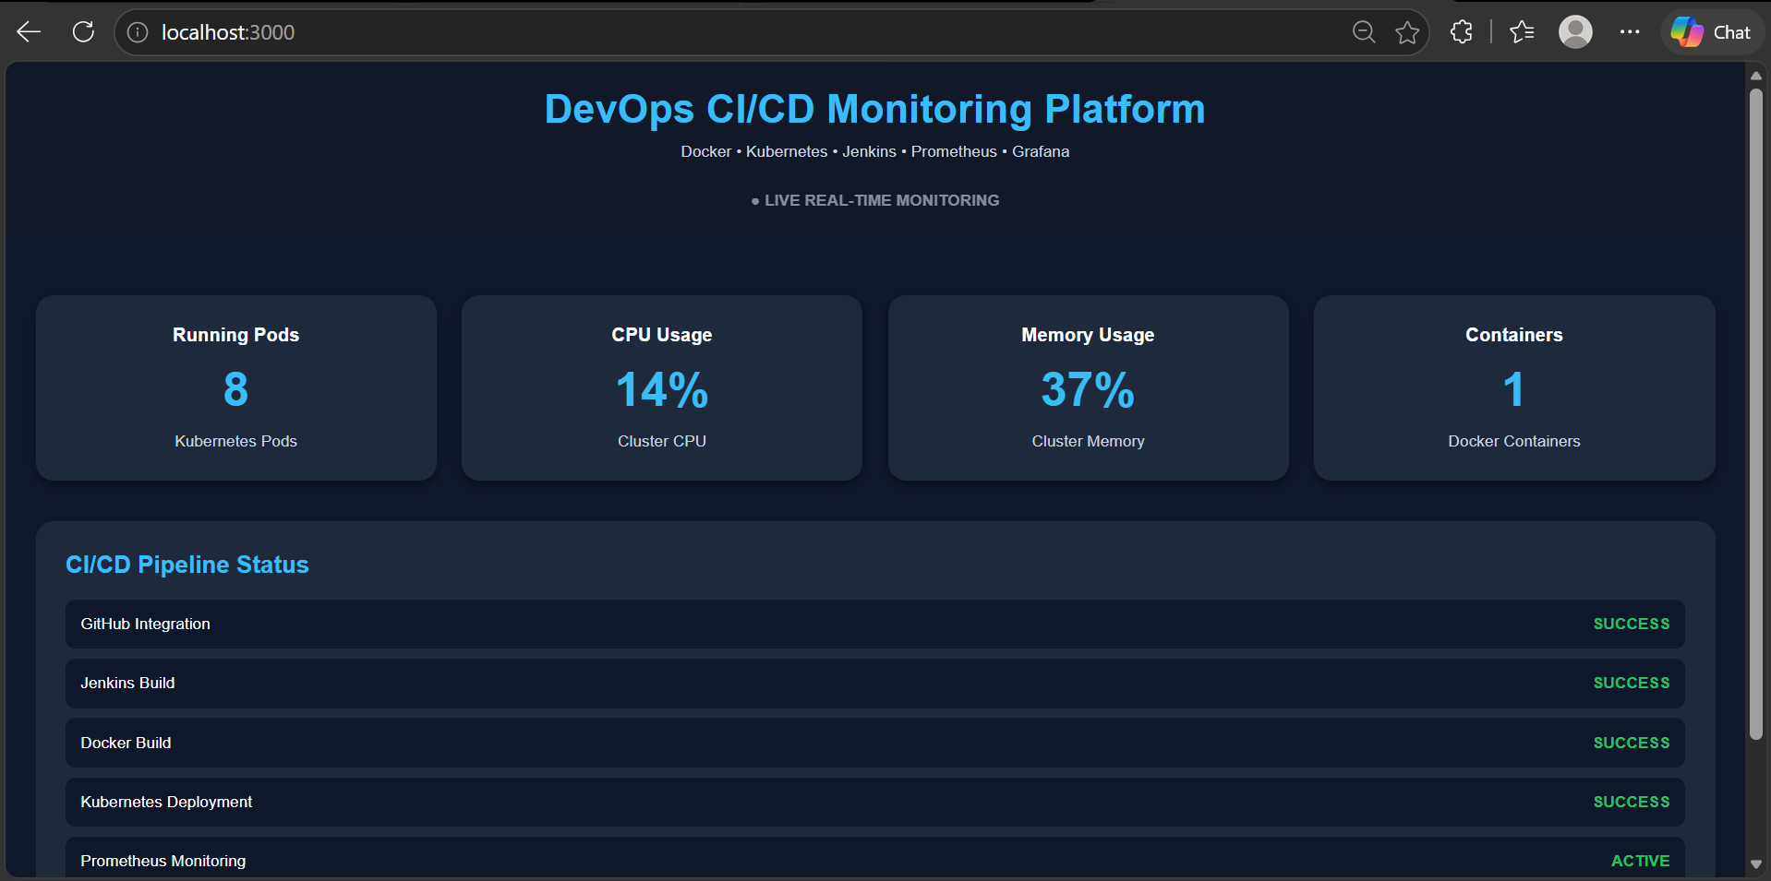

Slide 4
TECHNOLGIES
🐳Docker
📦 Docker Hub
☸️ Kubernetes
🤖Jenkins
🏗️Terraform
📊Prometheus
📈Grafana
🐙GitHub

Slide 5
DOCKER
Docker is a containerization platform used to package an application and all its dependencies into a Container so the application can run anywhere consistently
Docker packages:
code
libraries
dependencies
runtime
configuration , inside one container.

Slide 6
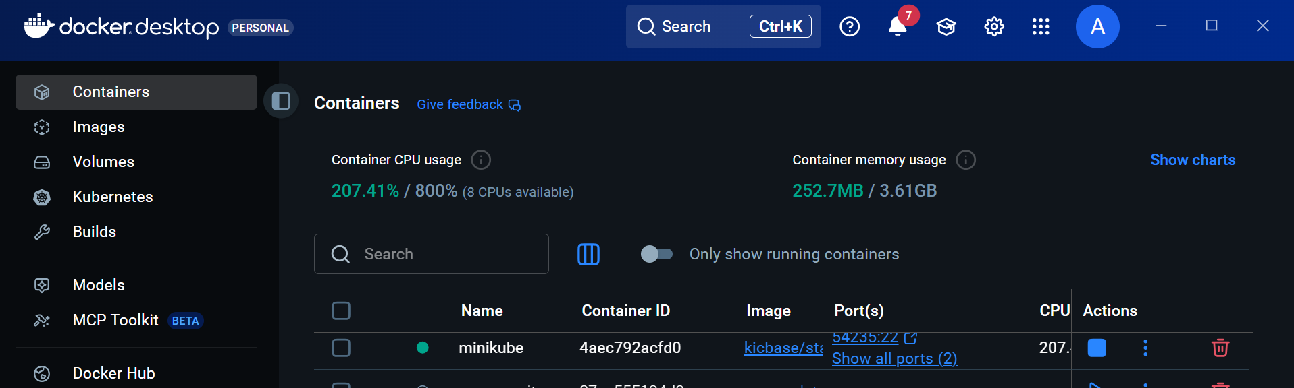

Slide 7
DOCKER HUB
Docker Hub is an online repository/registry for Docker images used to:
store Docker images
share Docker images
download Docker images
Docker Hub helps:
✅ store application image
✅ share container image
✅ deploy image into Kubernetes

Slide 8
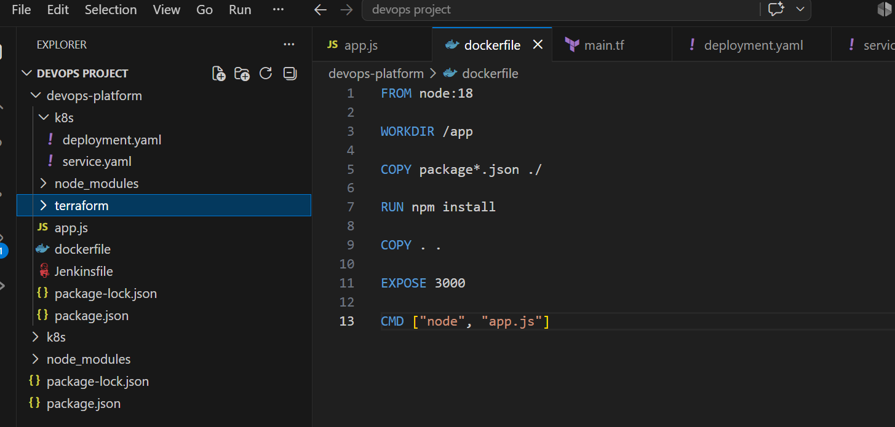

Slide 9
KUBERNETES
Kubernetes is: a container orchestration platform used to:
deploy containers
manage containers
scale containers
monitor containers automatically.
Docker can run one container, but Kubernetes can run one or more containers
In my Project Kubernetes is used to:
✅ deploy Docker container
✅ create pods
✅ manage replicas

Slide 10
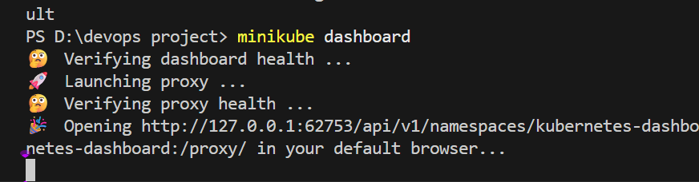
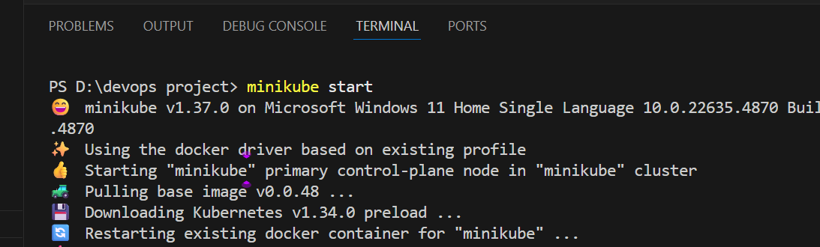

Slide 11
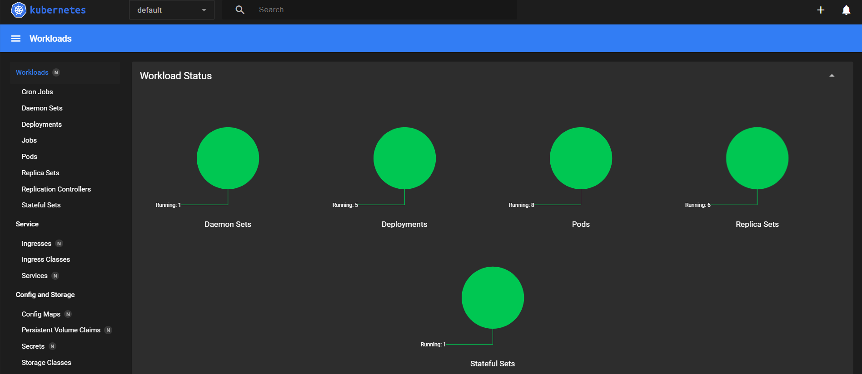

Slide 12
JENKINS
Jenkins is an automation server used to automate the,
building applications
testing applications
deploying applications through CI/CD pipelines
CI ( Continuous Integration) : developers continuously push code,
and Jenkins integrates/builds automatically.
CD( Continuous Deployment ): application automatically deploys after build.

Slide 13
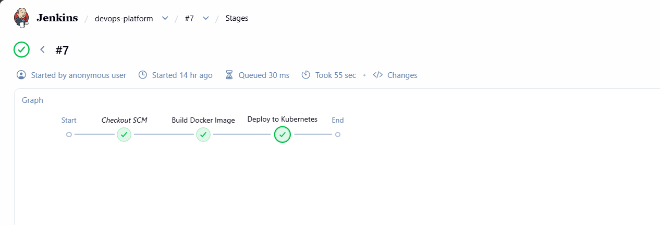

Slide 14
TERRAFORM
Terraform is an Infrastructure as Code (IaC) tool used to:
create infrastructure
manage infrastructure
automate infrastructure using configuration files.
automate Docker infrastructure
create Docker image, container
Infrastructure means:
servers
containers
networks

Slide 15
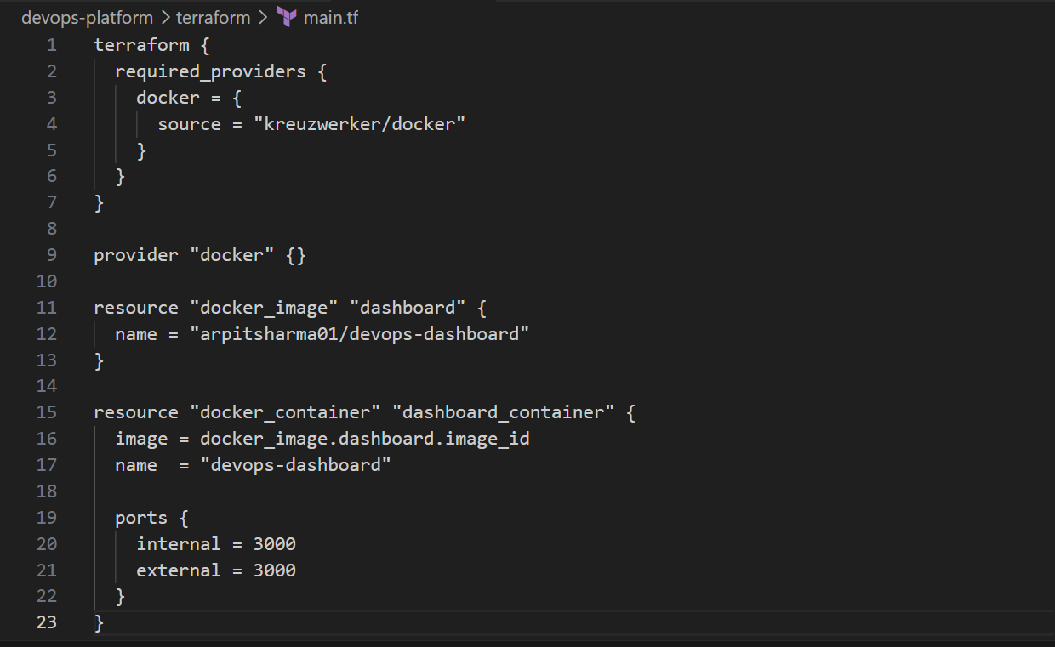

Slide 16
PROMETHEUS
Prometheus is: a monitoring and metrics collection tool used to:
collect system metrics
monitor applications
monitor Kubernetes clusters
track CPU and memory usage in real time.
Node Exporter is a Prometheus exporter used to collect hardware and operating system metrics such as CPU, memory, disk, and network usage from servers or Kubernetes nodes.

Slide 17
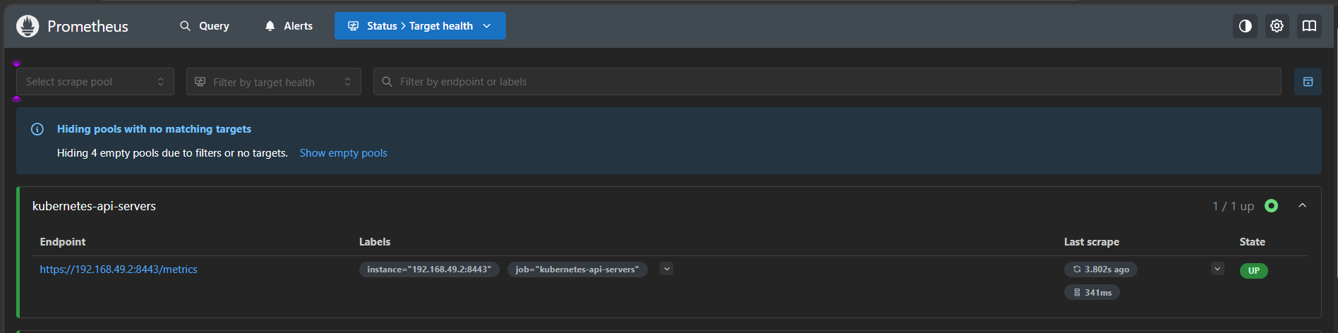

Slide 18
GRAFANA
Grafana is a visualization and monitoring dashboard tool used to:
display metrics
create dashboards
visualize monitoring data
monitor infrastructure in real time
Grafana converts raw monitoring data into:
graphs
charts
dashboards
visual analytics

Slide 19
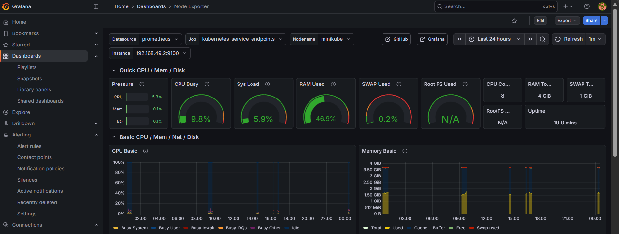

Slide 20
GITHUB
GitHub is a cloud-based source code hosting platform used to:
store code
manage code
track changes
collaborate with developers using Git version control system
GitHub is used to:
✅ store project source code
✅ connect with Jenkins

Slide 21
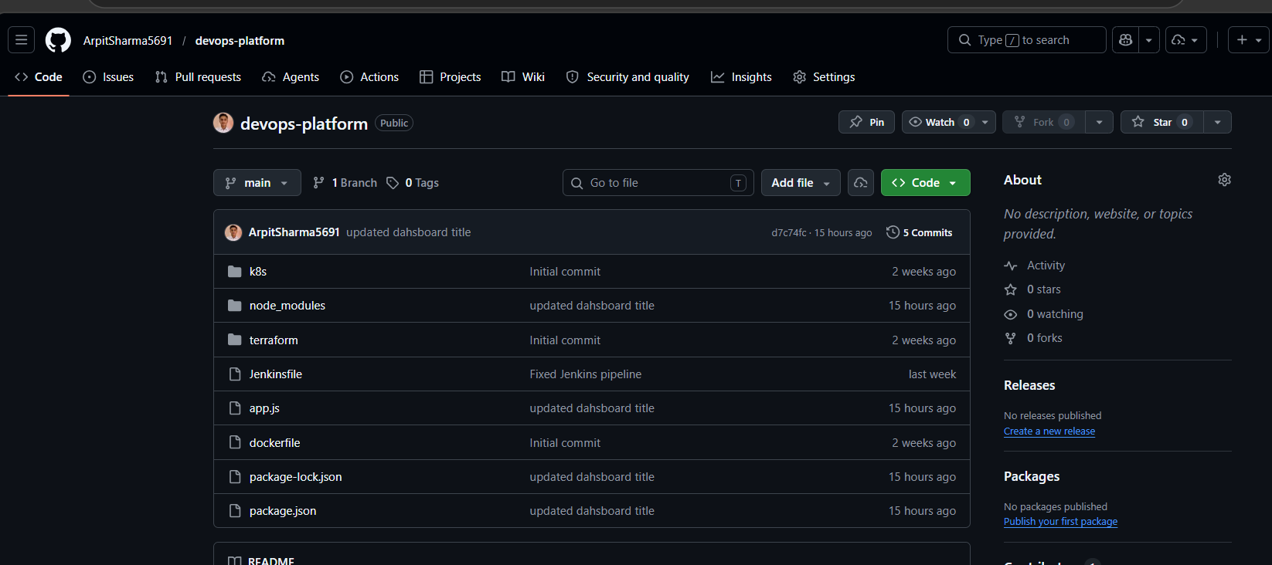

Slide 22
THANK YOU

